Slide 1
Fitness Tracker
By William Perkins

Slide 2
My fitness tracker is designed to help people workout based on what their current weight, what they lift and how many times they go to the gym. I want to add AI and my personal experience to help ensure people are getting the correct workout based on what they want to do. For example, on my program currently, there are question for users to answer to sort they workouts based on time, and if they want to gain or lose weight. The Next page of this presentation will show what the program looks like and how it works.
Overview of project

Slide 3
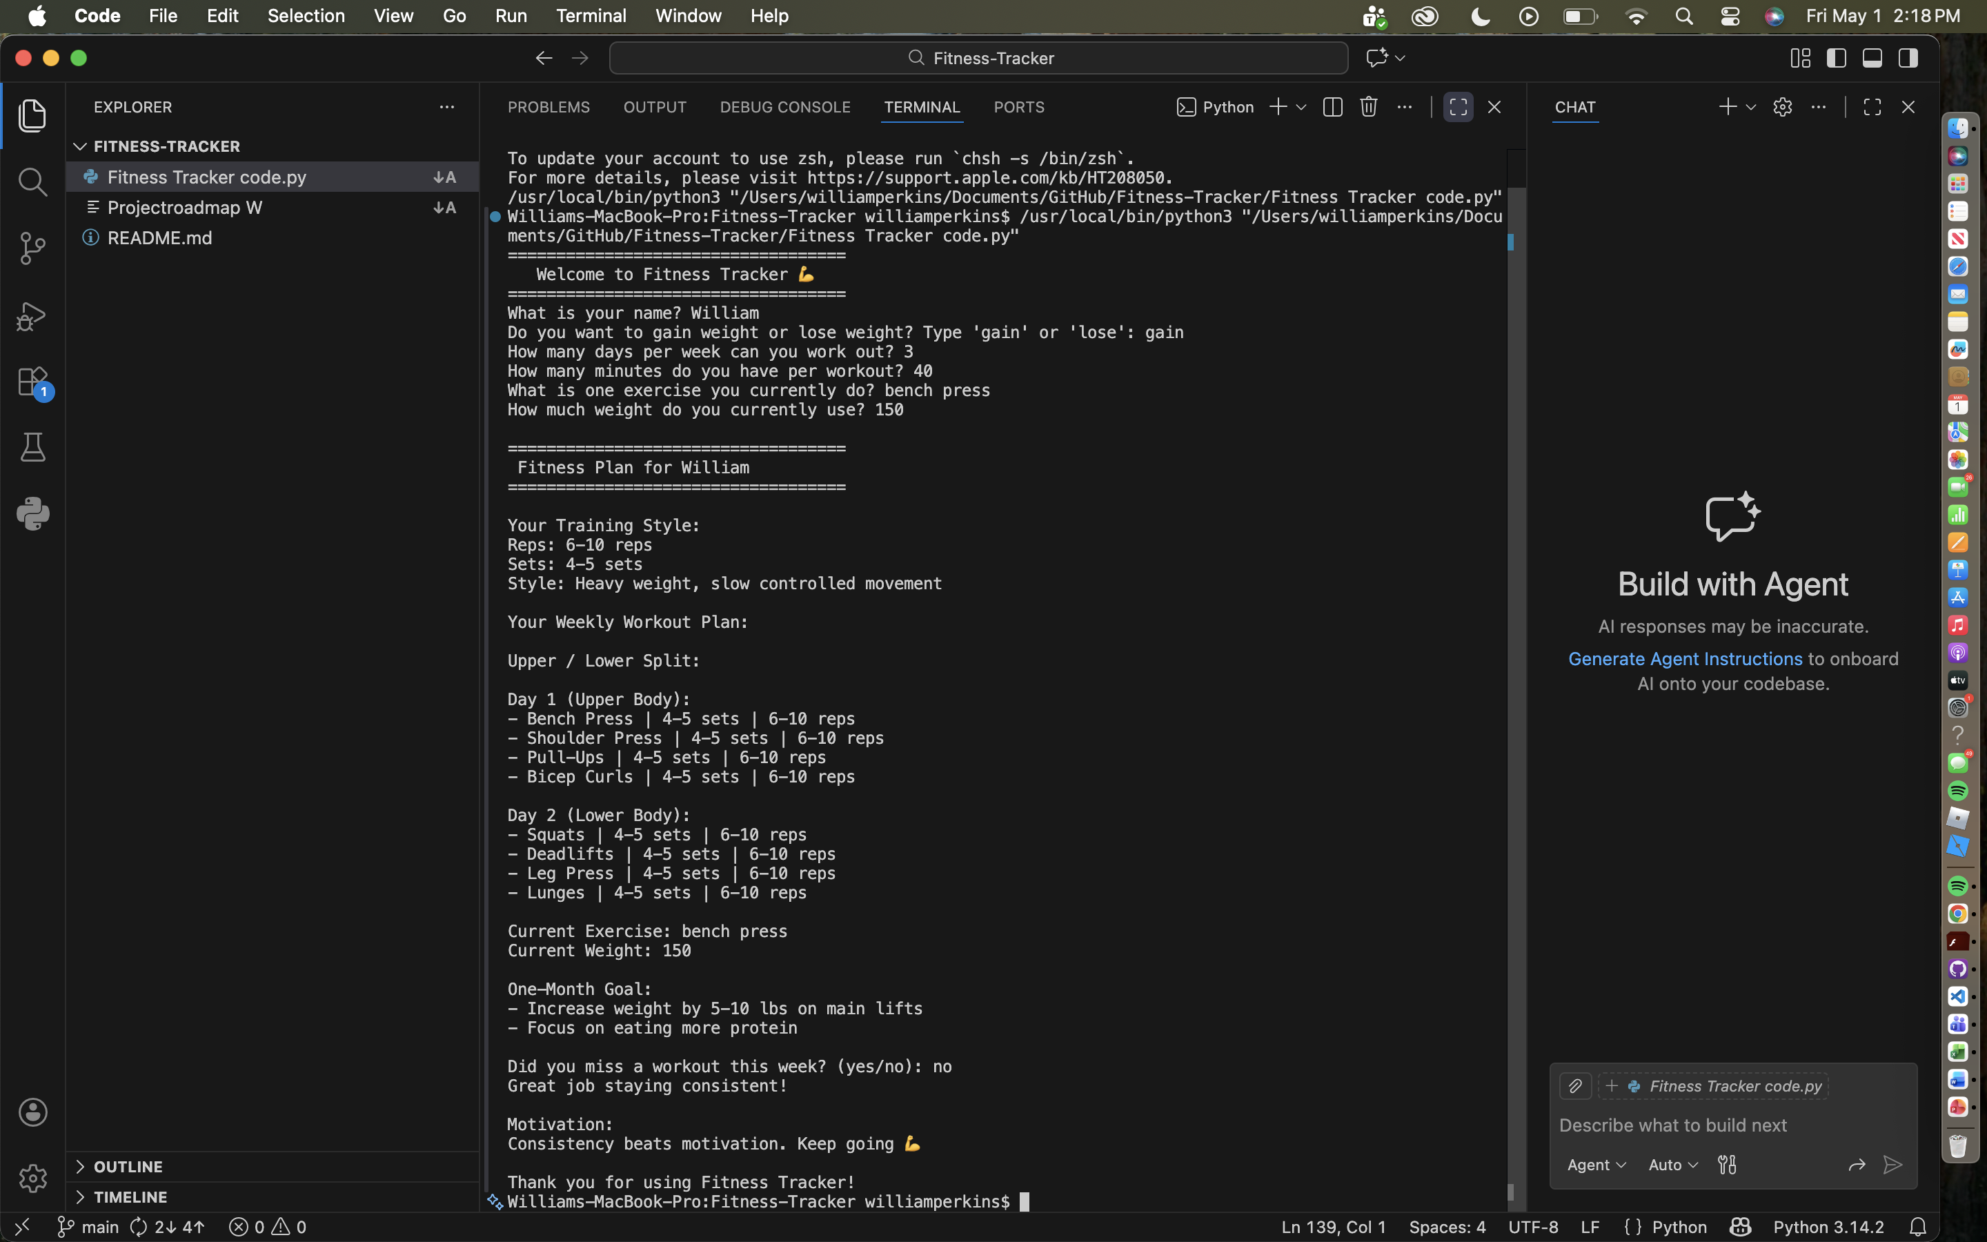

Slide 4
Behind the programming
Induces a welcome message with your name
Ask for weight and what you currently lift
Ask for how many days and minutes you workout for
Based on the information you give it will give you a set workout for all the days you want with reps and sets.
Then it sets a one month goal and a motivation speech.
I also added a miss workout which will generate another workout for you during the week.

Slide 5
What I want to add and improve on the fitness tracker
I want to add more workouts using AI and video.
I want to add more questions to narrow down the workouts and what the user wants.
I want to add more to the miss days and the motivation speech based on what workout there are doing.
For example, keep pushing if they are doing pushing exercises.
I believe that this program can become something significant and would love for people to try and and invest there time into getting better everyday.
Thank you.

